Slide 1


Data Analysis Using Python
Lecture:
Data Visualization part 2
www.bennett.edu.in
Notes:
Add Caption : Expect More
1

Slide 2
What Are Bar Plots?
A bar graph, a graphical representation of data, employs rectangles to emphasize specific categories.
The length and height of the bars depict the dataset distribution. One axis represents a category, while the other represents values or counts.
Barplot vs Histograms: Which Plot to Use?
Histograms, a valuable data representation tool, vividly illustrate continuous data distribution. Barplots serve as graphical depictions of frequency distributions for both continuous and discrete datasets.

Slide 3
Common Use Cases for Bar Plots
Comparing frequencies or counts: Bar plots can be used to compare the frequency or count of data points in different categories. For example, you could use a bar plot to compare the number of books sold in different genres.
Displaying proportions: Bar plots can be used to display proportions, such as the percentage of respondents who selected each option in a survey.
Visualizing changes over time: Bar plots can be used to display changes in categorical data over time, such as the number of sales in different months or the number of new customers in different years.
Comparing multiple variables: By grouping bar plots, you can compare multiple variables simultaneously. For example, you could compare the number of books sold by different authors and by different genres.
Displaying nominal data: Bar plots are a common way to display nominal data, which is data that has no inherent order or structure, such as hair color or preferred drink.

Slide 4
Creating a Bar Plot in Python Using Matplotlib
Matplotlib is a maths library widely used for data exploration and visualization.
It is simple and provides us with the API to access functions like the ones used in MATLAB.
The Matplotlib bar() function is the easiest way to create a bar chart. We import the library as plt and use:
plt.bar(x, height, width, bottom, align)
The “width” parameter determines the width of each bar in the bar chart.

Slide 5
Example:
import numpy as np
import matplotlib.pyplot as plt
# Dataset generation
data_dict = {'CSE':33, 'ECE':28, 'EEE':30}
courses = list(data_dict.keys())
values = list(data_dict.values())
fig = plt.figure(figsize = (10, 5))
# Bar plot
plt.bar(courses, values, color ='green', width = 0.5)
plt.xlabel("Courses offered")
plt.ylabel("No. of students enrolled")
plt.title("Students enrolled in different courses")
plt.show()

Slide 6
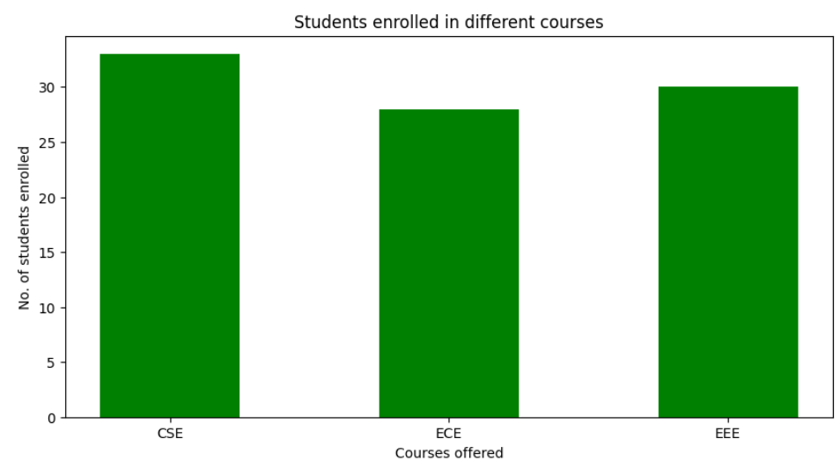

Slide 7
Types of Bar Plots in Python
Unstacked Bar Plots
Unstacked bar plots are used to compare a particular category over time with different samples. It can be used to deduct some facts from the pattern we observe through the comparison. In the figure below, we can see the players’ ratings over the years in FIFA.
import pandas as pd
plotdata = pd.DataFrame({"2018":[57,67,77,83],"2019":[68,73,80,79],"2020":[73,78,80,85]}, index=["Django", "Gafur", "Tommy", "Ronnie"])
plotdata.plot(kind="bar",figsize=(15, 8))
plt.title("FIFA ratings")
plt.xlabel("Footballer")
plt.ylabel("Ratings")

Slide 8
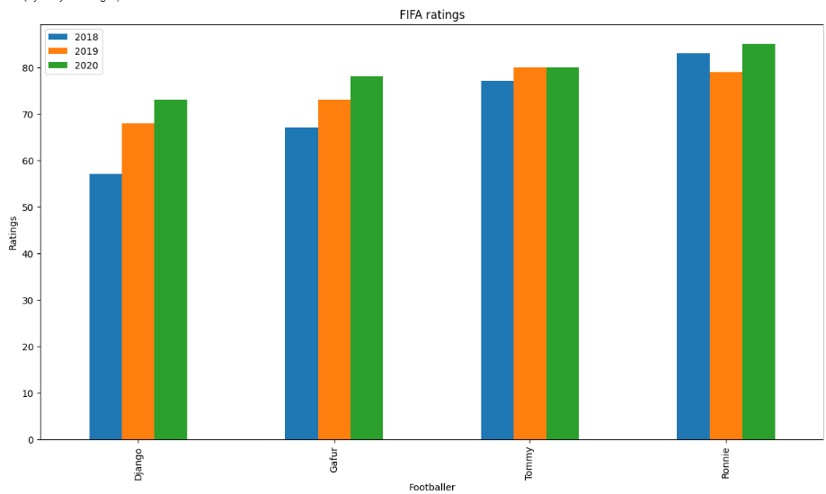

Slide 9
Stacked Bar Plots
stacked bar charts/plots have each plot stacked one over them.
unstacked bar chart to compare each group; we can use a stacked plot to compare each individual.
import pandas as pd
plotdata = pd.DataFrame({
"2018":[57,67,77,83],
"2019":[68,73,80,79],
"2020":[73,78,80,85]},
index=["Django", "Gafur", "Tommy", "Ronnie"])
plotdata.plot(kind='bar', stacked=True,figsize=(15, 8))
plt.title("FIFA ratings")
plt.xlabel("Footballer")
plt.ylabel("Ratings")

Slide 10
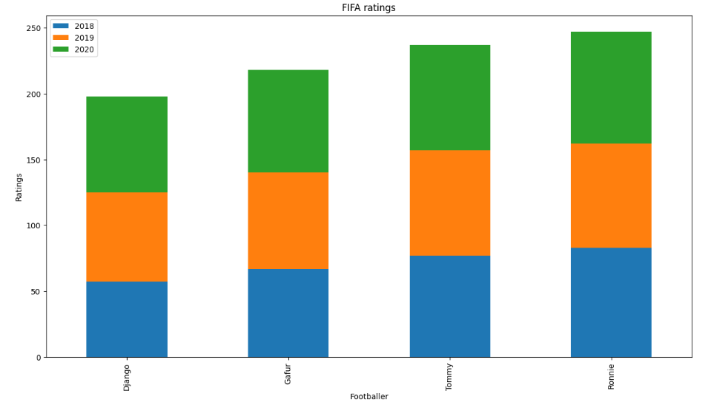

Slide 11
Analysis of Bar Plots in Python
we will use the Summer Olympics Medal 1976- 2008 dataset and visualize it using bar graphs to generate univariate, bivariate, and multivariate analysis and interpret relevant information from it.
The Summer Olympics dataset from 1976 to 2008 is available.
Univariate Analysis
In exploratory data analysis, Univariate analysis refers to visualizing one variable. In our case, we want to visualize column data using a bar plot.
All-time medals of top 10 countries:
import pandas as pd
df=pd.read_csv('/content/Olympic.csv', encoding='latin-1')
#df.head()
top_10 = df['Country'].value_counts()[:10]
top_10.plot(kind='bar',figsize=(10,8))
plt.title('All Time Medals of top 10 countries')

Slide 12
import pandas as pd
df=pd.read_csv('/content/Olympic.csv', encoding='latin-1')
#df.head()
top_10 = df['Country'].value_counts()[:10]
top_10.plot(kind='bar',figsize=(10,8))
plt.title('All Time Medals of top 10 countries')

Slide 13
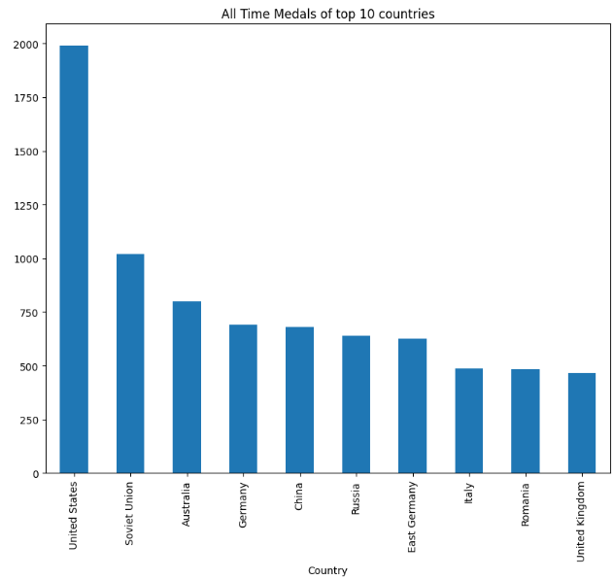

Slide 14
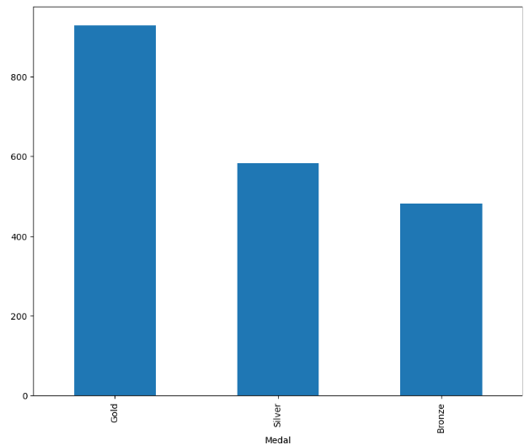
Medals won by the USA in Summer Olympics:
indpie = df[df['Country']=='United States']['Medal'].value_counts() indpie.plot(kind='bar',figsize=(10,8))

Slide 15
Bivariate Analysis
The bivariate analysis includes two variables or two columns from our dataset.
Total athletes’ contribution to Summer Olympics over time: plt.figure(figsize=(10, 5))
sns.countplot(df['Year’])
plt.title('Total Athletes contribution in summer olympics over time') plt.xlabel('Years’)
plt.ylabel('No. of Athlete')

Slide 16
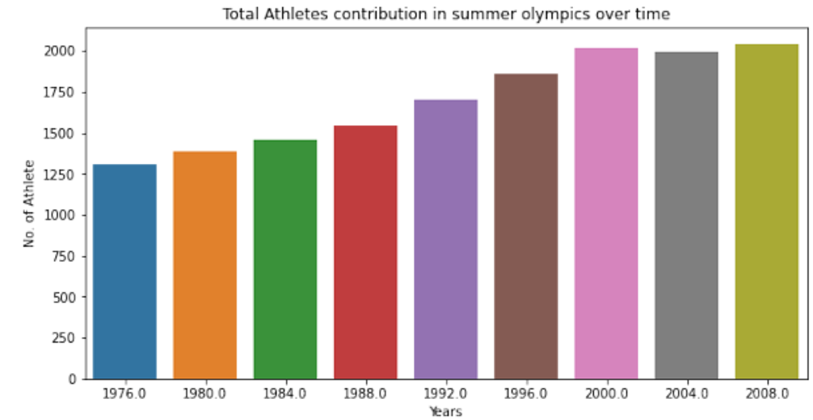

Slide 17
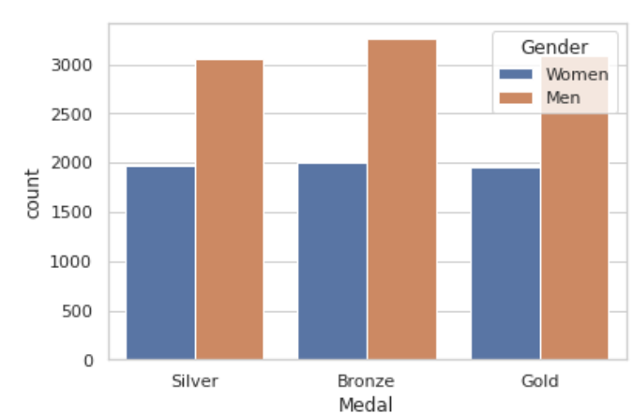
Medals by gender:
sns.countplot(x="Medal", hue="Gender", data=df)

Slide 18
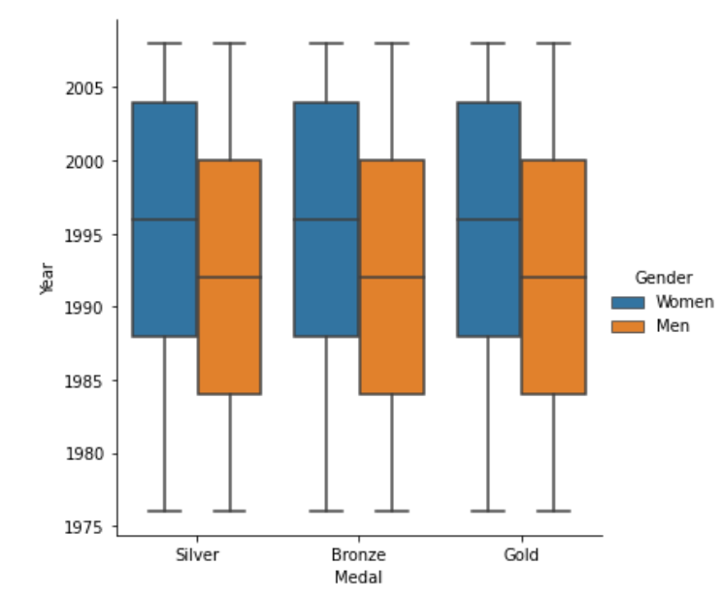
Multi-Variate Analysis
Multivariate analysis is used when we want to compare more than two categories. Usually, a boxplot is a good representation, as shown here.
sns.catplot(x="Medal", y="Year", hue="Gender",kind="box", data=df)

Slide 19
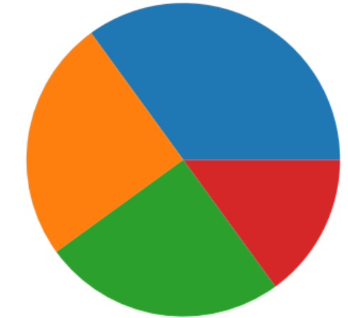
Matplotlib Pie Charts
Example: 1
import matplotlib.pyplot as plt import numpy as np y = np.array([35, 25, 25, 15]) plt.pie(y) plt.show()
Result:

Slide 20
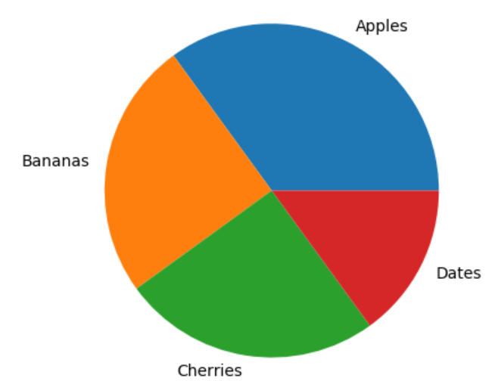
Example:2
import matplotlib.pyplot as plt import numpy as np y = np.array([35, 25, 25, 15]) mylabels = ["Apples", "Bananas", "Cherries", "Dates"] plt.pie(y, labels = mylabels) plt.show()

Slide 21
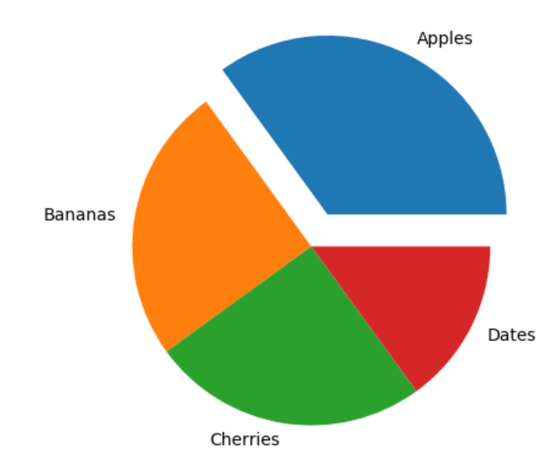
Example:3
import matplotlib.pyplot as plt import numpy as np y = np.array([35, 25, 25, 15]) mylabels = ["Apples", "Bananas", "Cherries", "Dates"] myexplode = [0.2, 0, 0, 0] plt.pie(y, labels = mylabels, explode = myexplode) plt.show()

Slide 22
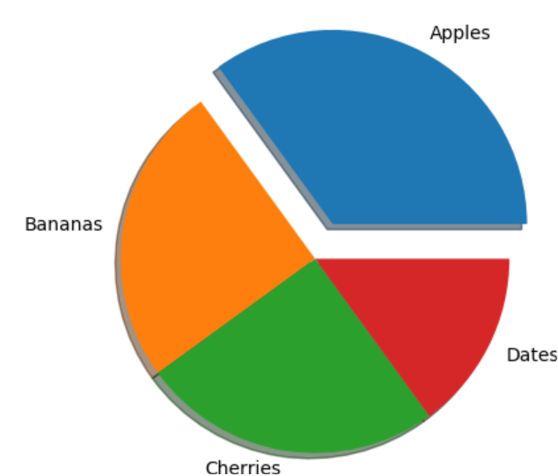
Shadow
Add a shadow to the pie chart by setting the shadows parameter to True:
Example:
Add a shadow:
import matplotlib.pyplot as plt import numpy as np y = np.array([35, 25, 25, 15]) mylabels = ["Apples", "Bananas", "Cherries", "Dates"] myexplode = [0.2, 0, 0, 0] plt.pie(y, labels = mylabels, explode = myexplode, shadow = True) plt.show()

Slide 23
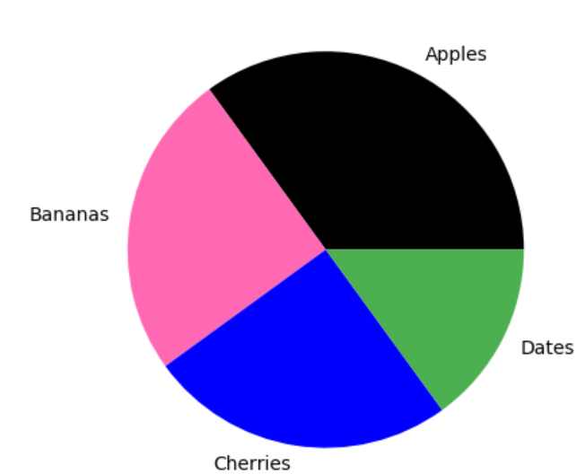
Colors
You can set the color of each wedge with the colors parameter.
The colors parameter, if specified, must be an array with one value for each wedge:
Example:
Specify a new color for each wedge:
import matplotlib.pyplot as plt import numpy as np y = np.array([35, 25, 25, 15]) mylabels = ["Apples", "Bananas", "Cherries", "Dates"] mycolors = ["black", "hotpink", "b", "#4CAF50"] plt.pie(y, labels = mylabels, colors = mycolors) plt.show()

Slide 24
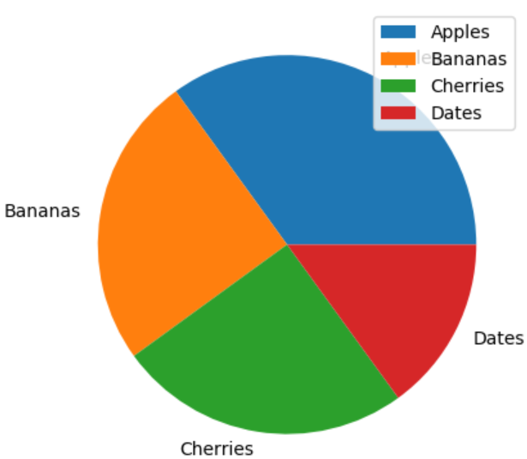
Legend
To add a list of explanation for each wedge, use the legend() function:
Example
Add a legend:
import matplotlib.pyplot as plt import numpy as np y = np.array([35, 25, 25, 15]) mylabels = ["Apples", "Bananas", "Cherries", "Dates"] plt.pie(y, labels = mylabels) plt.legend() plt.show()

Slide 25
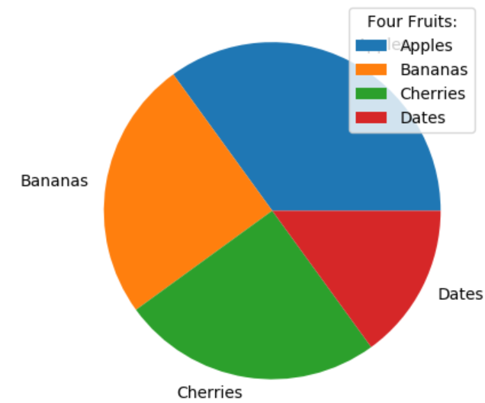
Legend With Header
To add a header to the legend, add the title parameter to the legend function.
Example:
Add a legend with a header:
import matplotlib.pyplot as plt import numpy as np y = np.array([35, 25, 25, 15]) mylabels = ["Apples", "Bananas", "Cherries", "Dates"] plt.pie(y, labels = mylabels) plt.legend(title = "Four Fruits:") plt.show()

Slide 26
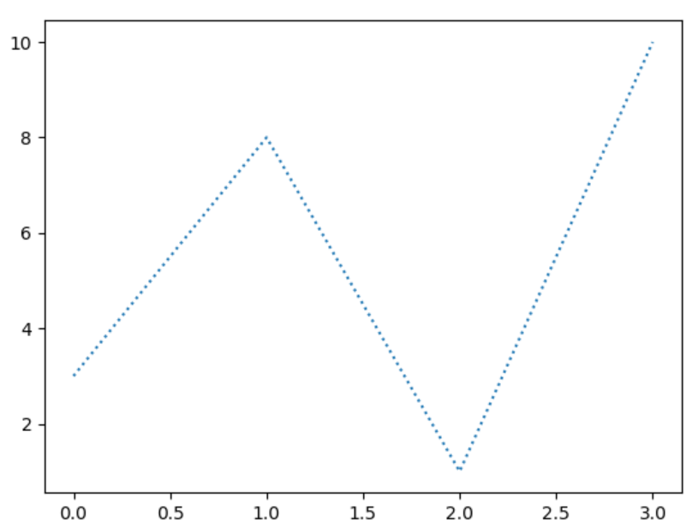
Matplotlib Line
Linestyle
You can use the keyword argument linestyle, or shorter ls, to change the style of the plotted line:
Use a dotted line:
import matplotlib.pyplot as plt import numpy as np ypoints = np.array([3, 8, 1, 10]) plt.plot(ypoints, linestyle = 'dotted') plt.show()

Slide 27
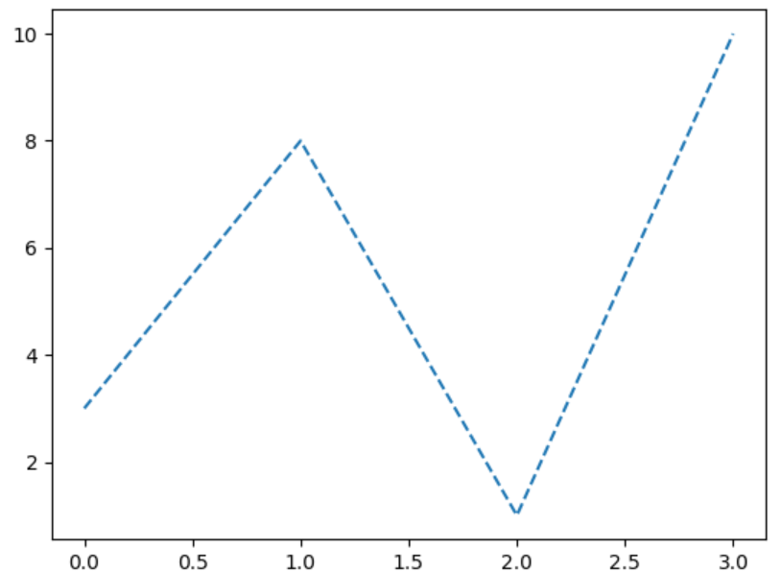
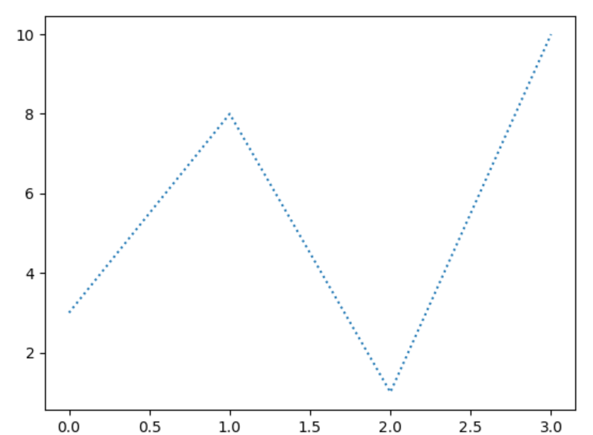
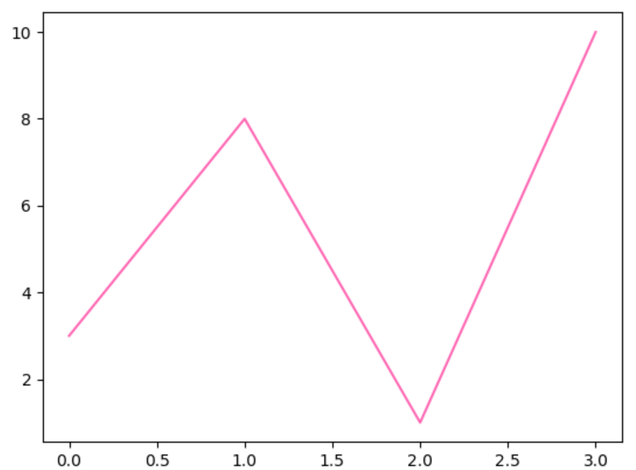
Example:
Use a dashed line:
plt.plot(ypoints, linestyle = 'dashed’)
Shorter Syntax
The line style can be written in a shorter syntax:
linestyle can be written as ls.
dotted can be written as :.
dashed can be written as --
plt.plot(ypoints, ls = ':’)
plt.plot(ypoints, c = 'hotpink’)

Slide 28
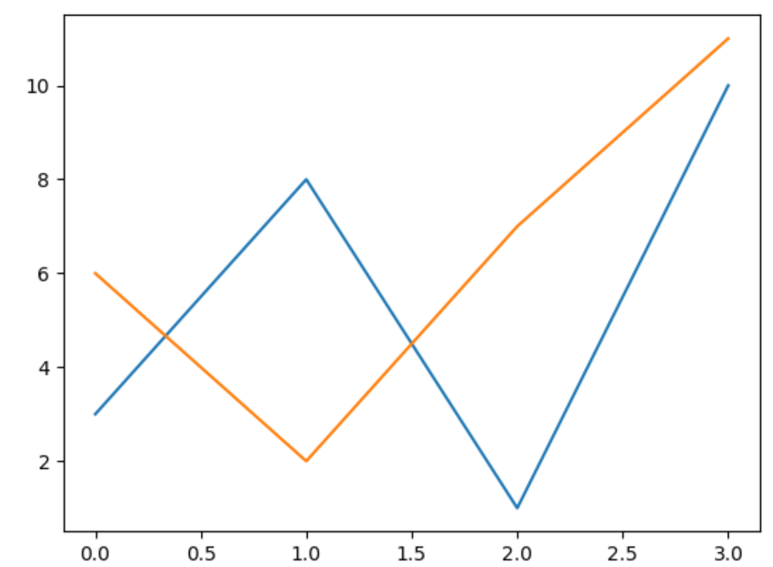
Multiple Lines
You can plot as many lines as you like by simply adding more plt.plot() functions:
Example:
Draw two lines by specifying a plt.plot() function for each line:
import matplotlib.pyplot as plt import numpy as np y1 = np.array([3, 8, 1, 10]) y2 = np.array([6, 2, 7, 11]) plt.plot(y1) plt.plot(y2) plt.show()

Slide 29
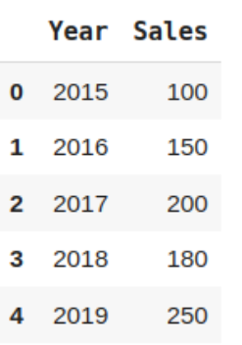
What is an Area Chart?
An area chart is a type of data visualization that displays quantitative data over time or categories.
It is similar to a line chart, but the area between the line and the x-axis is filled with color, visually representing the data’s magnitude.
import pandas as pd
data = {'Year': [2015, 2016, 2017, 2018, 2019],
'Sales': [100, 150, 200, 180, 250]}
df = pd.DataFrame(data)
df.head()

Slide 30
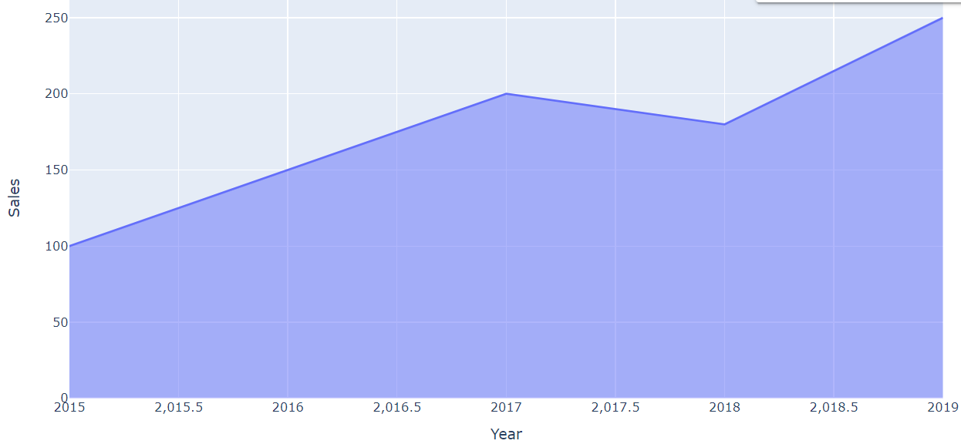
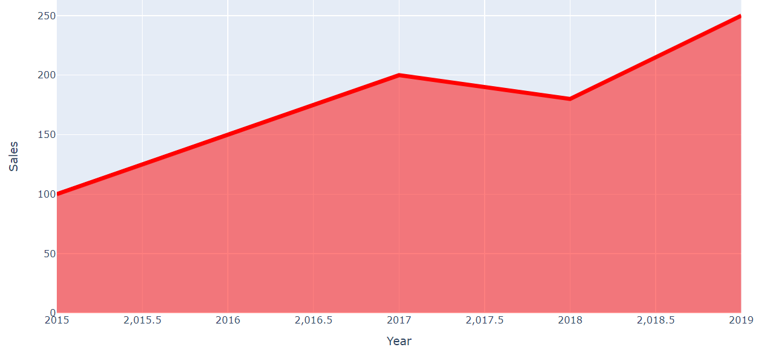
1. import plotly.express as px
fig = px.area(df, x='Year', y='Sales’)
fig.show()
2. import plotly.express as px
fig = px.area(df, x='Year', y='Sales') fig.update_traces(line=dict(color='red', width=5))
fig.show()

Slide 31
Creating Stacked Area Charts
Stacked area charts are handy when we want to compare the contribution of different categories to the total.
They are commonly used in finance, economics, and other fields where it is essential to understand the composition of a whole.
Firstly, they allow us to visualize each category’s total value and individual contributions. This helps us understand the relative importance of each category and how it changes over time.
Secondly, stacked area charts make identifying trends and patterns in the data easy. By stacking the areas on top of each other, we can see how the composition of the whole changes over time.

Slide 32
import plotly.express as px
# Create a dataframe with random values
data = pd.DataFrame({ 'Year': [2015, 2016, 2017, 2018, 2019], 'Category A': [10, 20, 30, 40, 50], 'Category B': [20, 30, 40, 50, 60], 'Category C': [30, 40, 50, 60, 70] })
# Create a stacked area chart
fig = px.area(data, x='Year', y=['Category A', 'Category B', 'Category C'], title='Stacked Area Chart’)
fig.show()

Slide 33
